Slide 1


CUSTOM DYNAMIC MEMORY ALLOCATOR
A Deep Dive into Malloc/Free Simulation
Team Eklavya: Prashant Singh (24C22054) Mayank Singh (24C22037) Ankit Patel (24C22007)

Slide 2

Problem & Motivation
The "Black Box": Standard functions like malloc and free abstract away complex memory management logic.
•
Objectives
1. Simulate heap behavior using a Memory Pool.
The Goal: To deconstruct this abstraction by building a system that manages a raw block of memory manually.
•
2. Implement First-Fit allocation strategy.
•
3. Handle Block Splitting & Coalescing.
Key Concepts:
○
Pointer Arithmetic
4. Build a CLI for real-time interaction.
○
Memory Fragmentation
○
Linked List Traversal

Slide 3
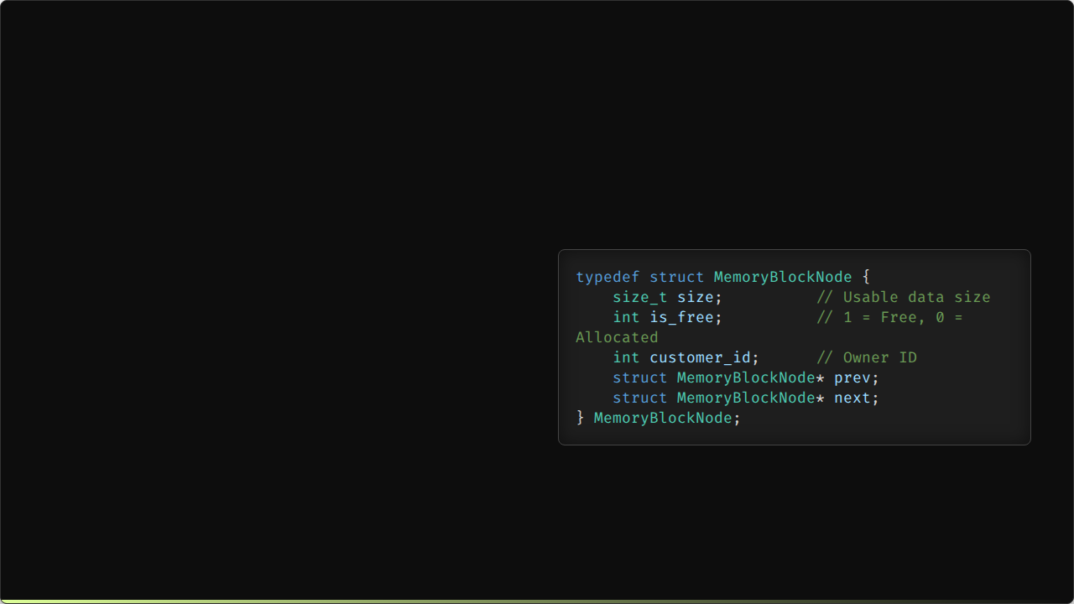
The Node Structure
At the core of our allocator is the MemoryBlockNode. This metadata header precedes every block of memory.
It creates a Doubly Linked List that allows us to traverse the heap in both directions, which is crucial for merging adjacent free blocks (coalescing).

Slide 4
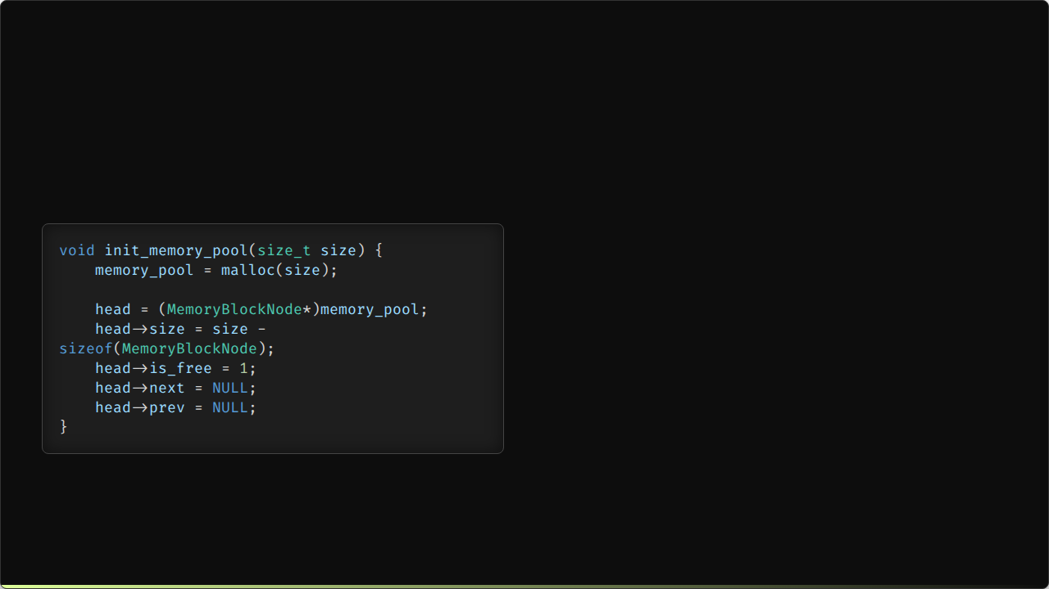

Initializing the Memory Pool
We allocate one large contiguous block from the OS using standard malloc.
This block is immediately cast to our custom node type. The initial state is a single giant free block.

Slide 5
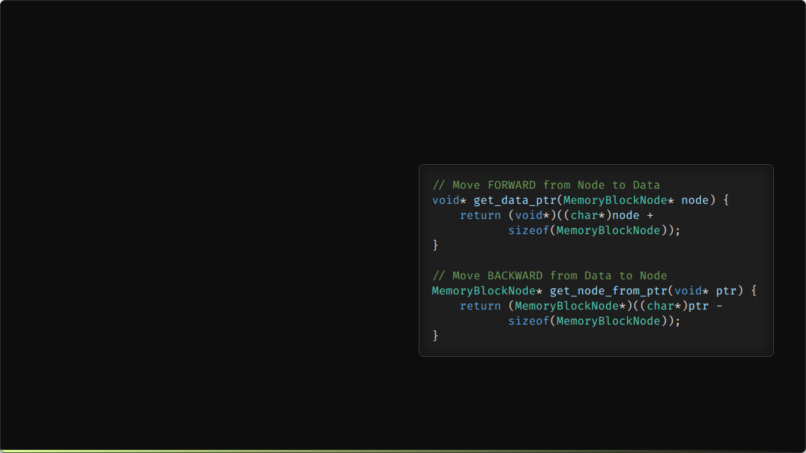
Pointer Arithmetic
Navigating between the Metadata Header and the User Data requires precise pointer arithmetic.
Key Challenge: C pointer addition depends on the type size. We cast to char* (1 byte) to ensure byte-level precision when calculating addresses.

Slide 6






Strategy: First-Fit Allocation
1. Search
2. Split
3. Assign
Traverse the linked list starting from head. Stop at the first block where is_free == 1 and size >= request.
If the found block is significantly larger than requested, split it into two: one allocated block and one smaller free block.
Mark the block as allocated, assign the customer_id, and return the pointer to the data area.

Slide 7
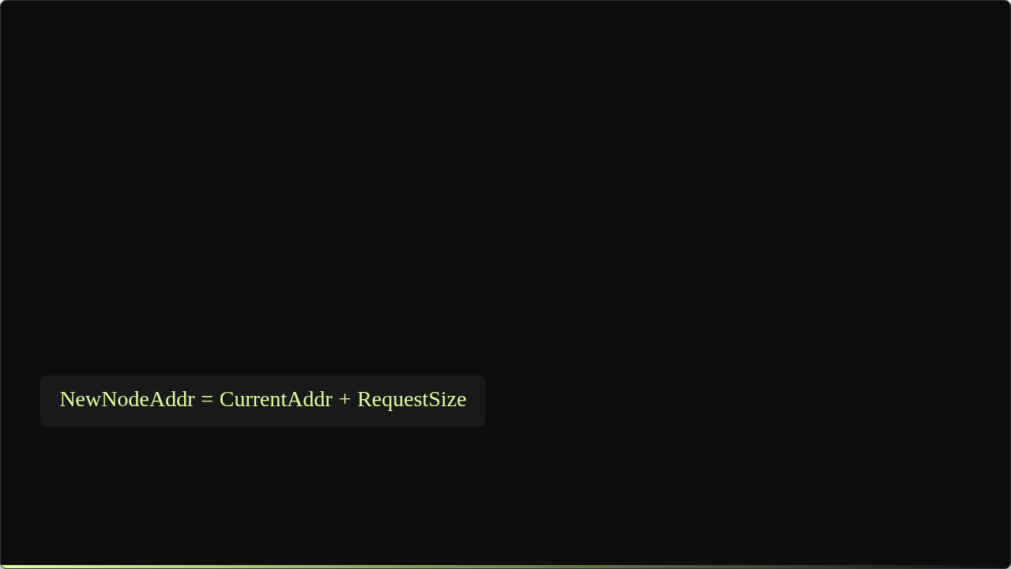

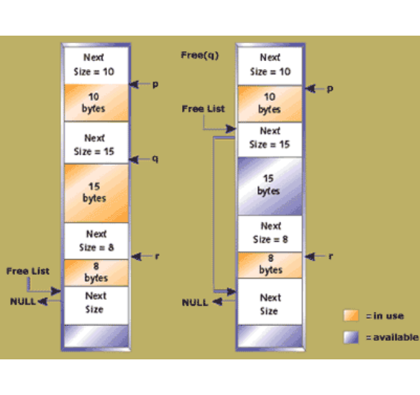
Visualizing Block Splitting
When a large free block is found, we split it to minimize Internal Fragmentation.
A new node is created at the exact address where the requested memory ends.

Slide 8
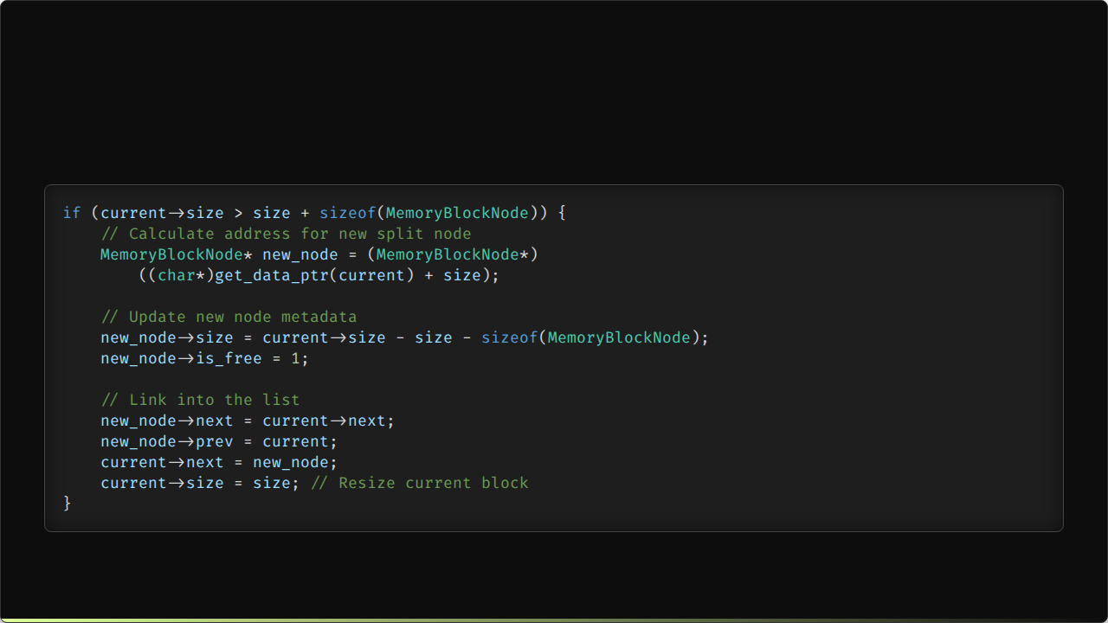
Code: Splitting Logic

Slide 9
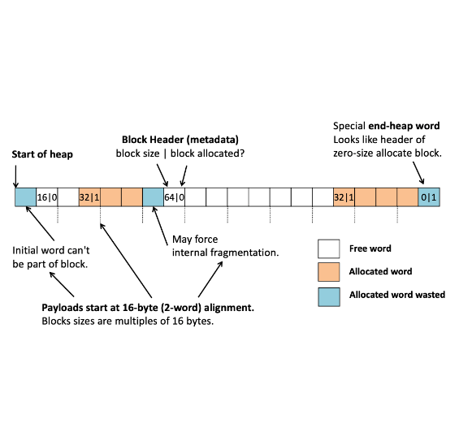
Strategy: Coalescing
Deallocation isn't just marking a block as free. If we only did that, we would end up with many tiny free blocks (External Fragmentation).
Coalescing is the process of merging adjacent free blocks into one larger block.
•
Check next node: If free, merge.
•
Check prev node: If free, merge.

Slide 10
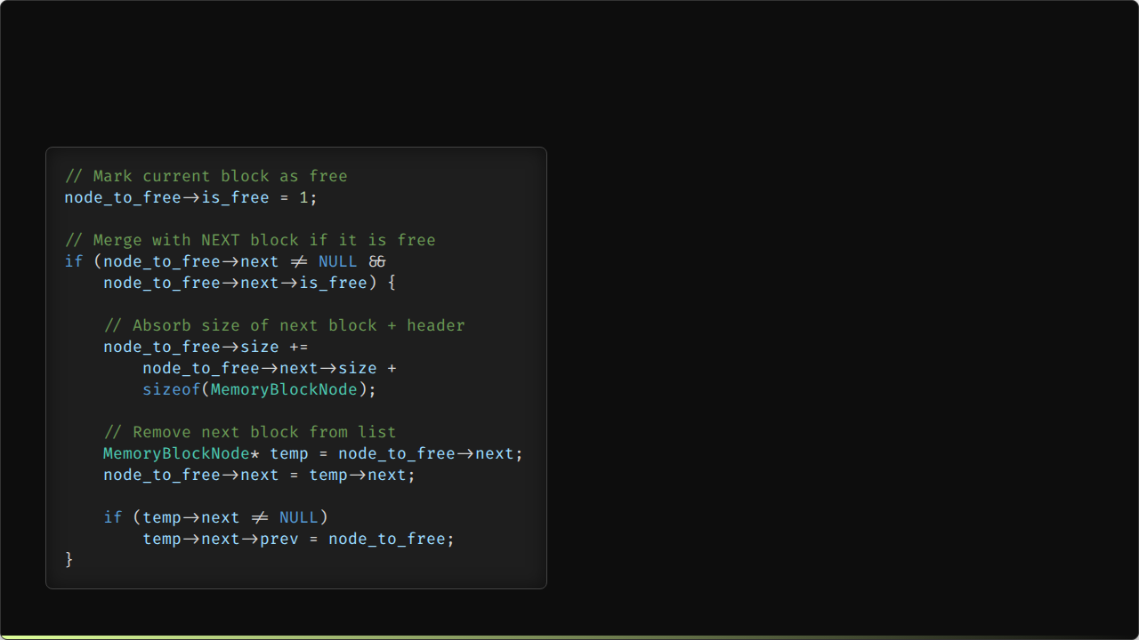
Code: Merging Forward
This snippet demonstrates Forward Coalescing.
If the neighbor to the right (next) is free, we expand the current node's size to cover it and bypass the neighbor's node in the linked list.

Slide 11
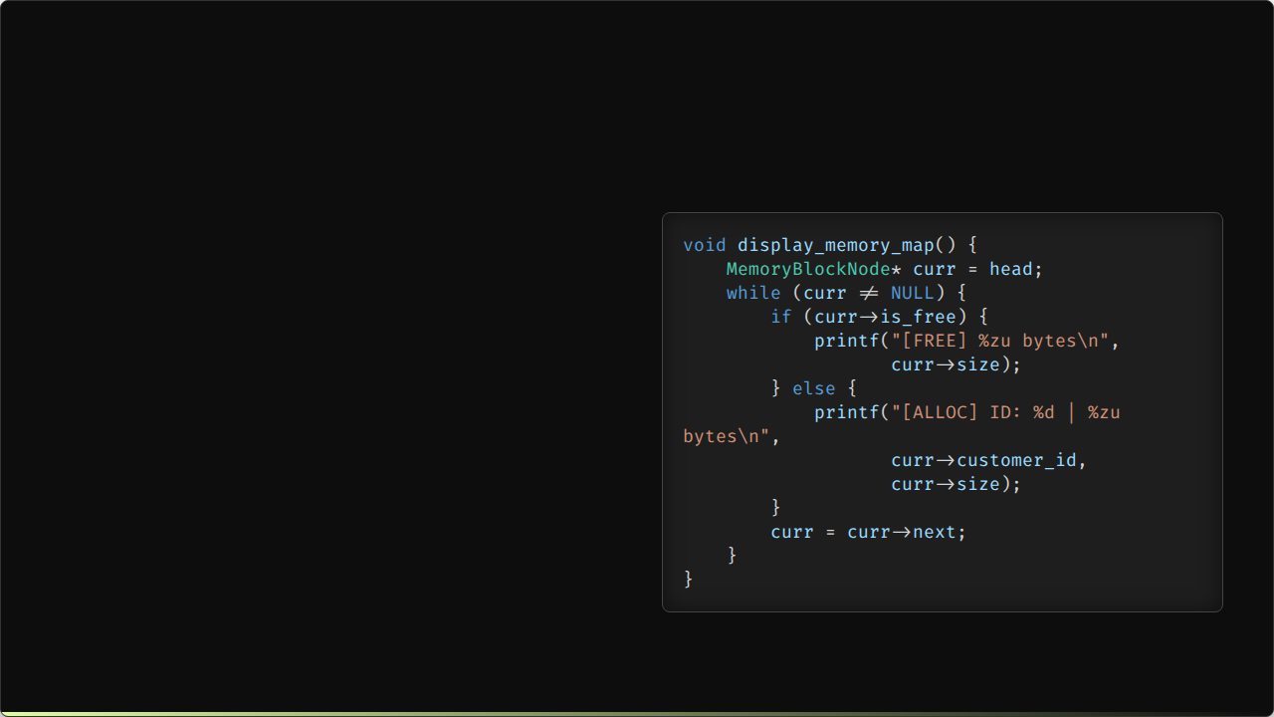
Memory Traversal
To visualize the heap state, we iterate through the list from head to tail.
This allows us to debug fragmentation issues by seeing exactly where free and allocated blocks are located.

Slide 12
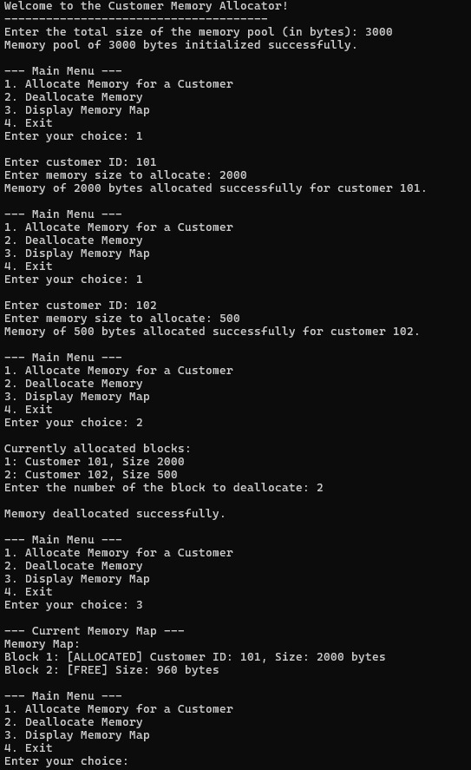
System Testing
The system is driven by a CLI menu offering:
1.
Allocate Memory
Deallocate Memory
2.
Display Map
3.
Exit
4.
We validated the system using edge cases:
•
Allocating more than pool size.
•
Double freeing pointers.
•
Fragmenting the pool then coalescing.

Slide 13






Conclusion & Future Scope
Learnings
Achievements
Future Work
Mastered pointer arithmetic and the internal mechanics of dynamic memory management beyond standard library calls.
Successfully implemented a First-Fit allocator with automatic block splitting and fragmentation-reducing coalescing.
Implement Best-Fit strategy, add thread safety (mutex locks), and support `realloc` functionality.

Slide 14
Q & A
Thank You!

Slide 15



Refrences
https://barrgroup.com/images/articles/SafeMemoryUtilization04MultipleHeapAllocations.gif
Source: barrgroup.com
https://awb.fyi/courses/cs208/s22/notes/images/implicit-free-list.png
Source: awb.fyi

